Slide 1
Engines of Growth
EIT Digital Master School @Eötvös Lorand University
Business Development Lab
Inspired by Eric Ries “The Lean Startup”

Slide 2
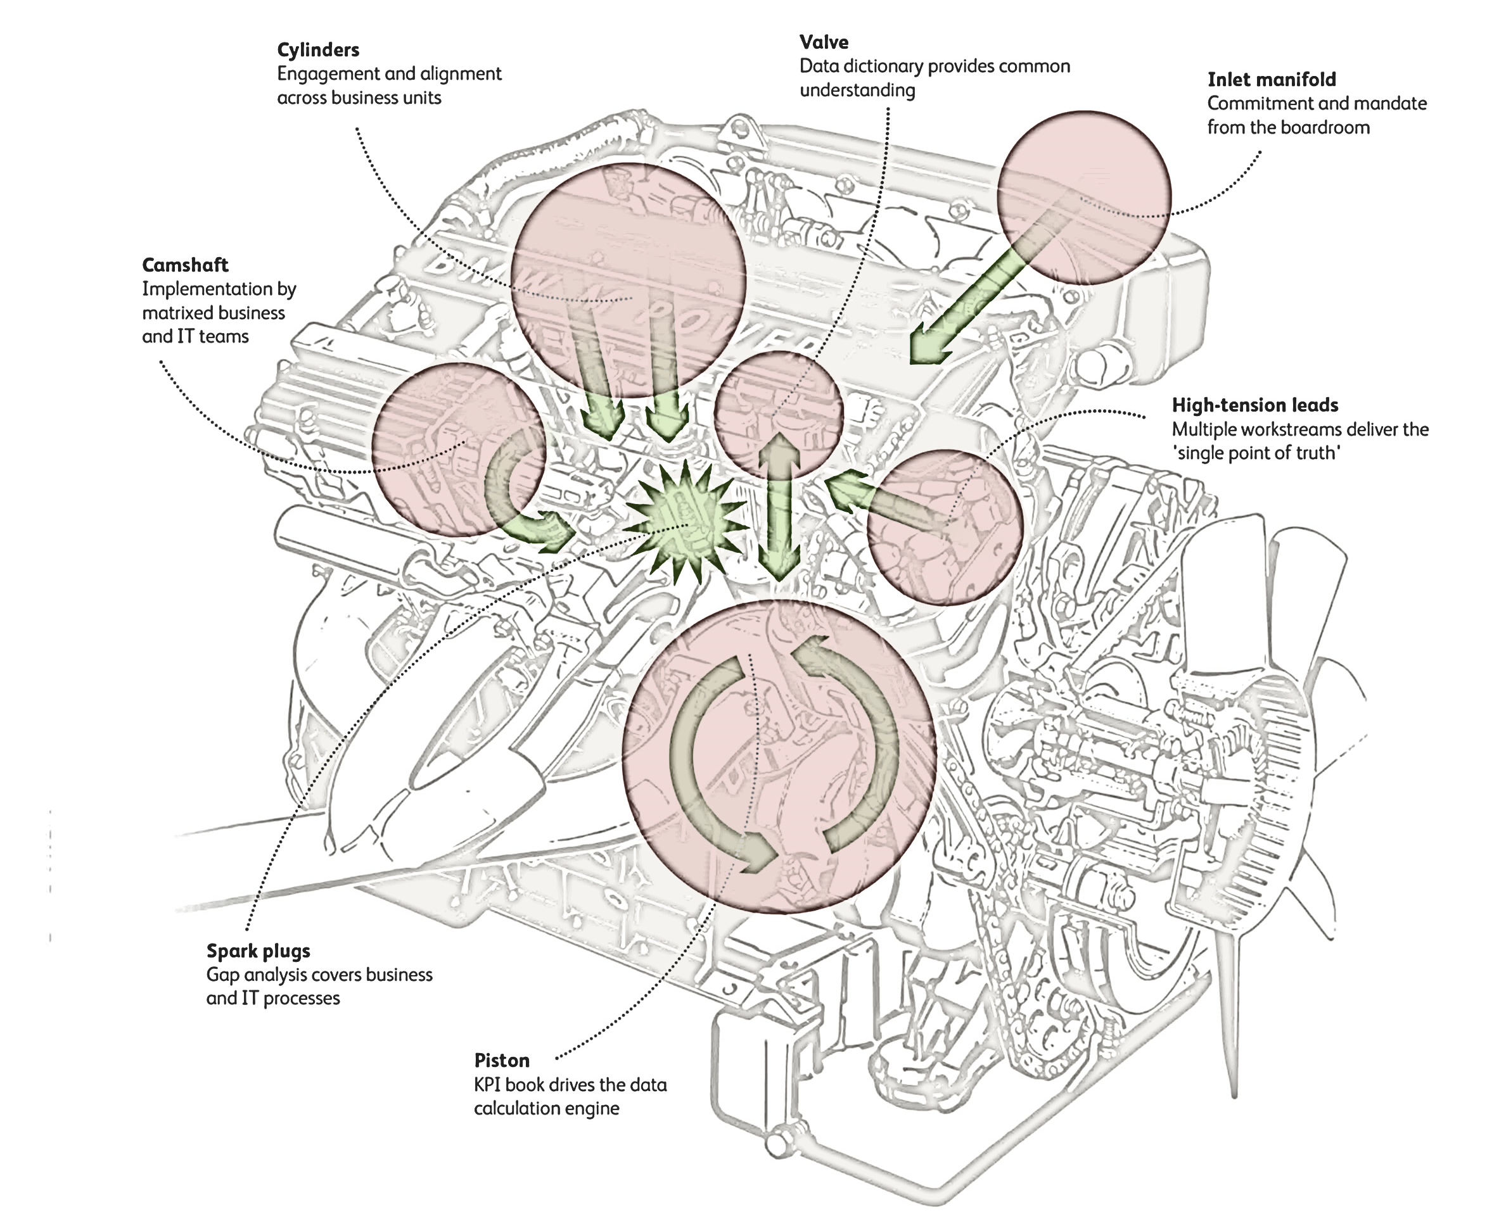
The engine of growth
The engine of growth is the mechanism that startups use to achieve sustainable growth.
Exclude all onetime activities that generate a surge of customers but have no long term
Impact and could not sustain a
growth for the long term.

Slide 3

Some more on this: going Lean
The Lean Startup
First proposed in 2008 by Eric Ries
Bestselling book: The Lean Startup (2011).
You can find it in the CLC library
3

Slide 4
Why Engines of Growth?
“Startups don’t starve; they drown.” Shawn Carolan
Ideas about how to make the product better: most are mere optimizations.
Startups have to focus on the big experiments that lead to validated learning.
The engines of growth framework helps stay focused on the metrics that matter.
4

Slide 5

Sustainable growth
characterized by one simple rule:
“New customers come from the actions of past customers.”

Slide 6
Sustainable growth sources
Four primary ways past customers drive sustainable growth:
Word of mouth.
Side effect of product usage.
Funded advertising.
Repeat purchase or use.
6

Slide 7
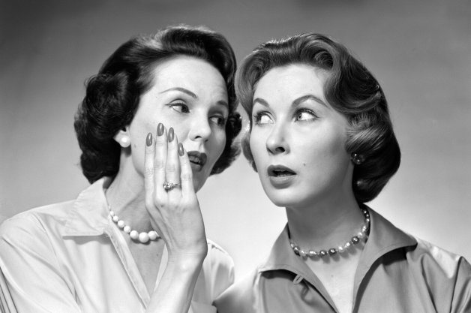
Word of mouth
7

Slide 8
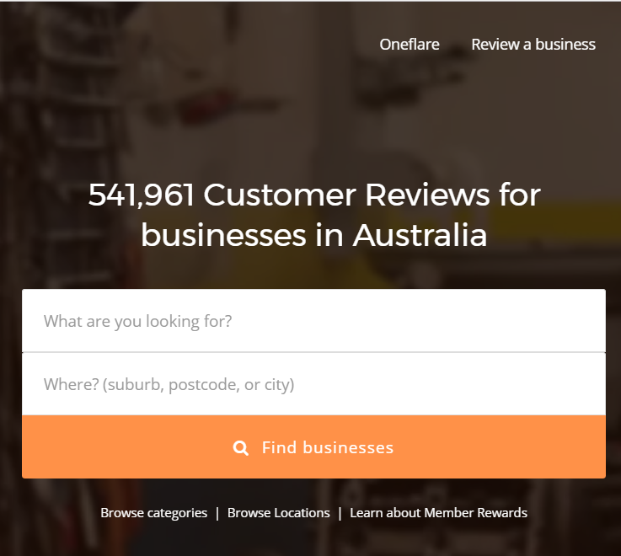
Word of mouth
Embedded in most products
Caused by satisfied customers’ enthusiasm for it.
That is what makes social media powerful
That is why we have recommendations & review sites/ forums
8

Slide 9
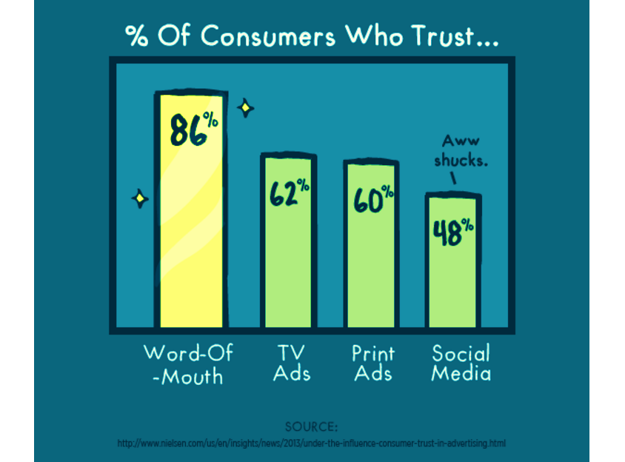
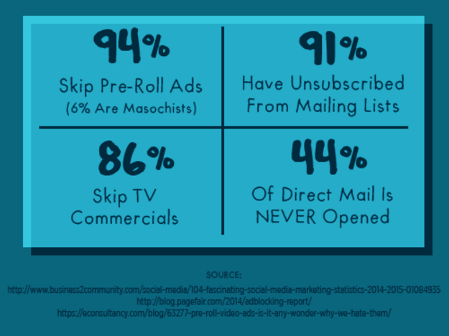
Why Word of mouth?
9

Slide 10
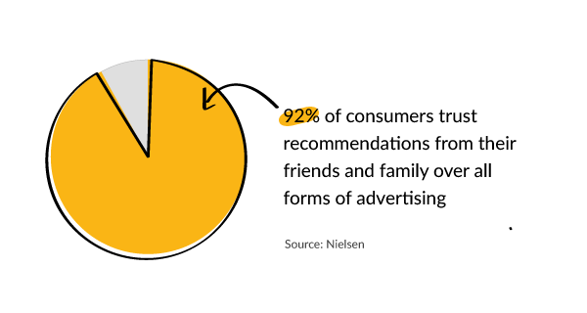
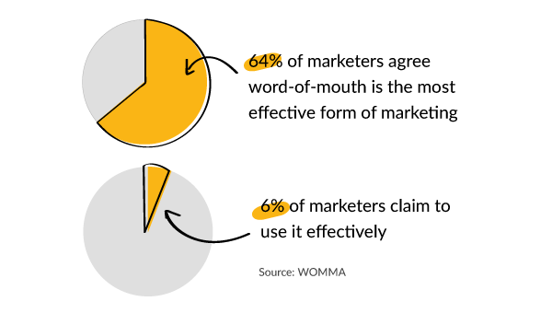
Why Word of mouth?
*http://www.nielsen.com/us/en/insights/news/2012/consumer-trust-in-online-social-and-mobile-advertising-grows.html
**https://www.forbes.com/forbes/welcome/?toURL=https://www.forbes.com/sites/kimberlywhitler/2014/07/17/why-word-of-mouth-marketing-is-the-most-important-social-media/&refURL=&referrer=
10

Slide 11
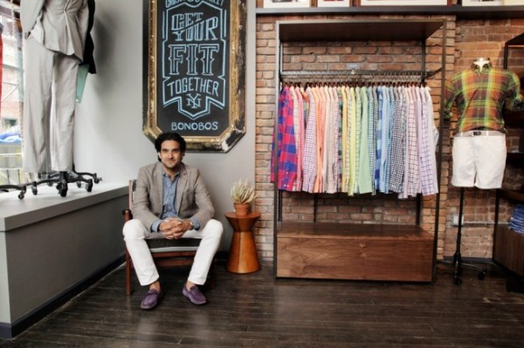
Word of mouth tips
Make your niche small. The smaller the niche is, the easier it gets for your audience to associate you with that one thing that you do.
Make that one thing really good. Make sure that it solves an actual problem people have.
*https://www.referralcandy.com/blog/niche-marketing-word-of-mouth-examples/
11

Slide 12
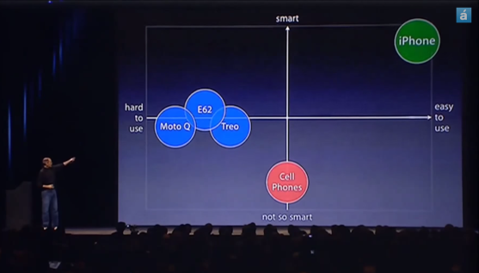

Word of mouth tips
3. Give this thing just one main feature/characteristic. It’s the feature that people will care for, it’s why they will pull out their wallets. The more there is, the more “whys” pop up.
4.Get word-of-mouth from the early adopters. Make it easy for the word-of- mouth to spread. Set your social media right, encourage people to share, participate in the conversations, etc.
12
*https://www.referralcandy.com/blog/niche-marketing-word-of-mouth-examples/

Slide 13
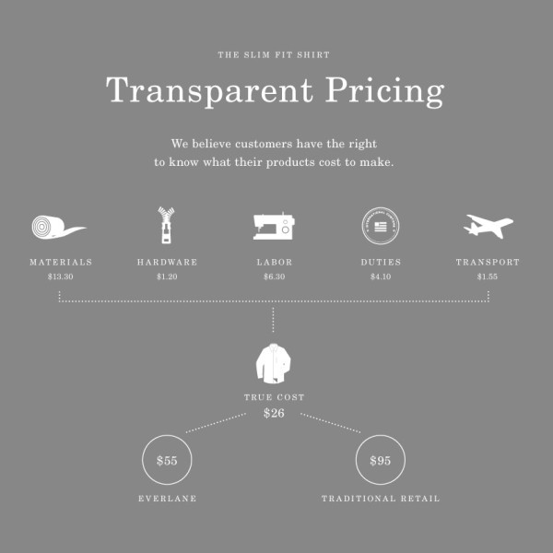
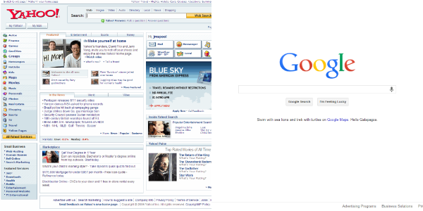
Word of mouth tips
*https://www.referralcandy.com/blog/niche-marketing-word-of-mouth-examples/
13

Slide 14


Product Usage Side Effect
14

Slide 15

Product Usage Side Effect
Fashion or status,
Luxury goods products,
Drive awareness of themselves whenever they are used.
Also true for viral products such as Facebook and PayPal:
When a customer sends money to a friend using PayPal, the friend is exposed automatically to the PayPal product.
15

Slide 16

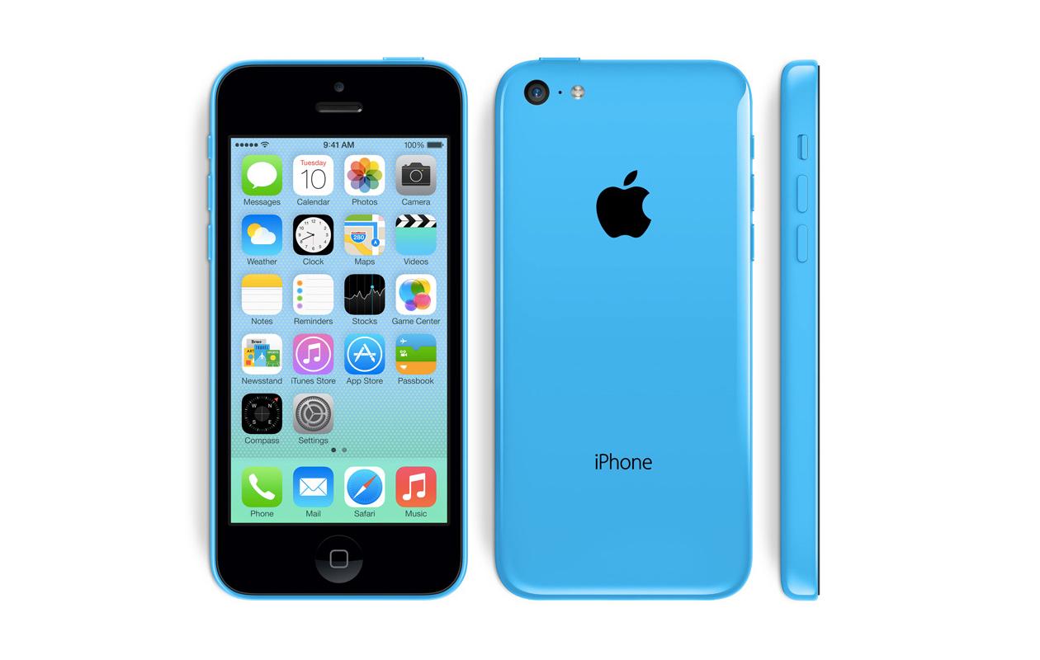

Product Usage Side Effect
iPhones, Louis vuitton purses, and Gmail are great examples
16

Slide 17
Difference with word-of-mouth
“Product that exhibit viral growth depend on person-to-person transmission as a necessary consequence of normal product use.”
Customers are not intentionally acting as evangelists;
Growth is a side effect of customers using the product.
Depends on making the product visible to others as each customer uses it.
WOM depends on delighting customers to the point where they voluntarily tell others about you.
17

Slide 18

Founded Advertisement
18

Slide 19

Founded advertising
“To be a source of sustainable growth, must be paid out of revenue, not one-time sources such as investment capital.” Eric Ries
Cost of acquiring a new customer (marginal cost) < marginal revenue
the excess (marginal profit) can be used to acquire more customers.
The more marginal profit, the faster the growth.
19

Slide 20
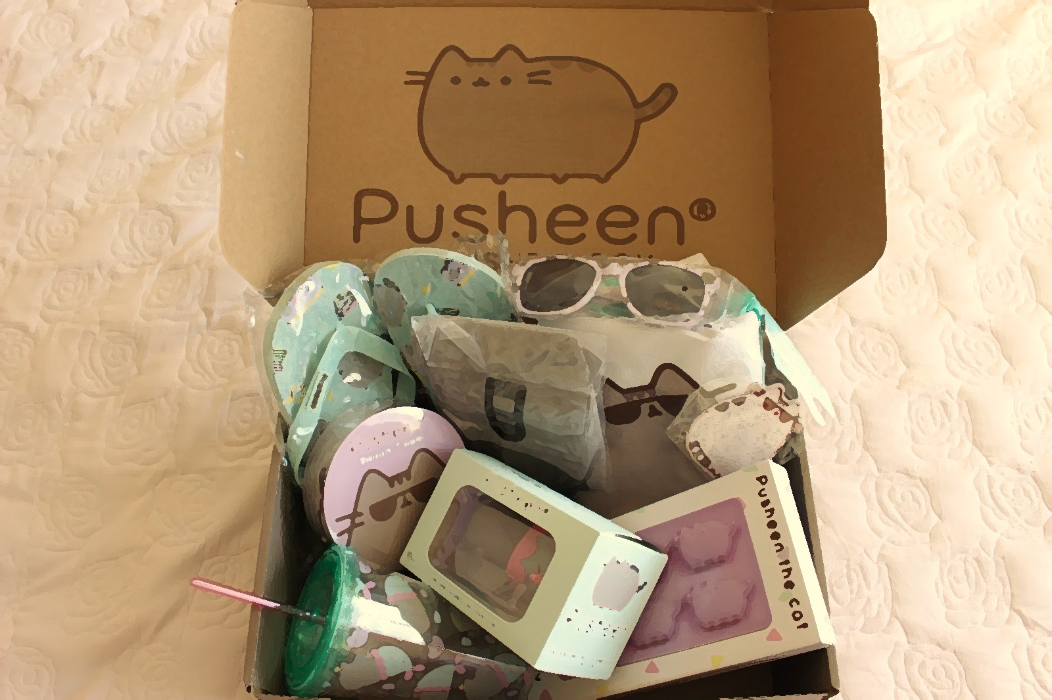
Repeated purchase or use
20

Slide 21
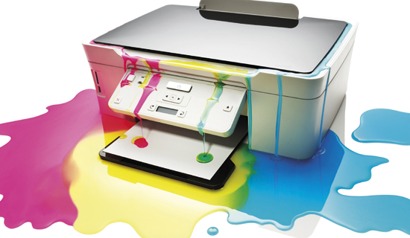
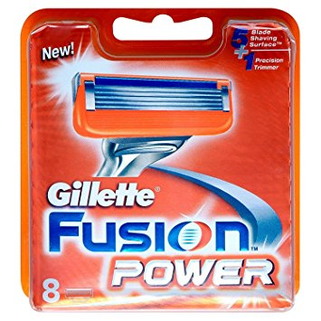
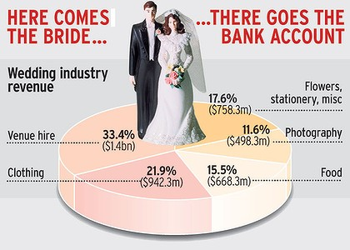
Repeated purchase or use
Some products are designed to be purchased repeatedly:
a subscription plan (ex. cable company)
voluntary repurchases (ex. groceries or lightbulbs).
Many products and services are intentionally one-time events (ex. wedding planning)
21

Slide 22
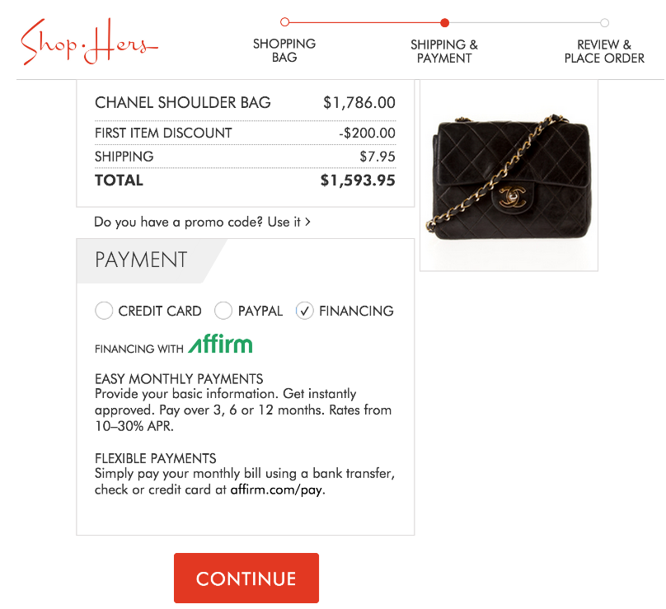
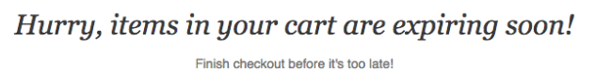
Incentivize Repeated purchase
Create “exclusive” discounts for loyal customers
2. Offer convenient customer financing
3. Retarget customers with abandoned cart emails or promotions for repeat purchase
4. Use email to send personalized offers and suggest products
22
https://www.affirm.com/content/increase-repeat-purchases-ecommerce/

Slide 23
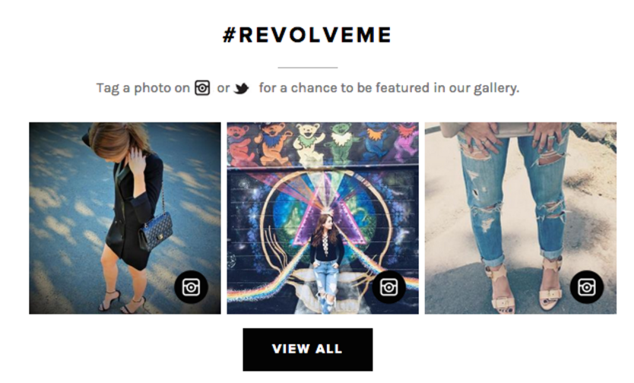
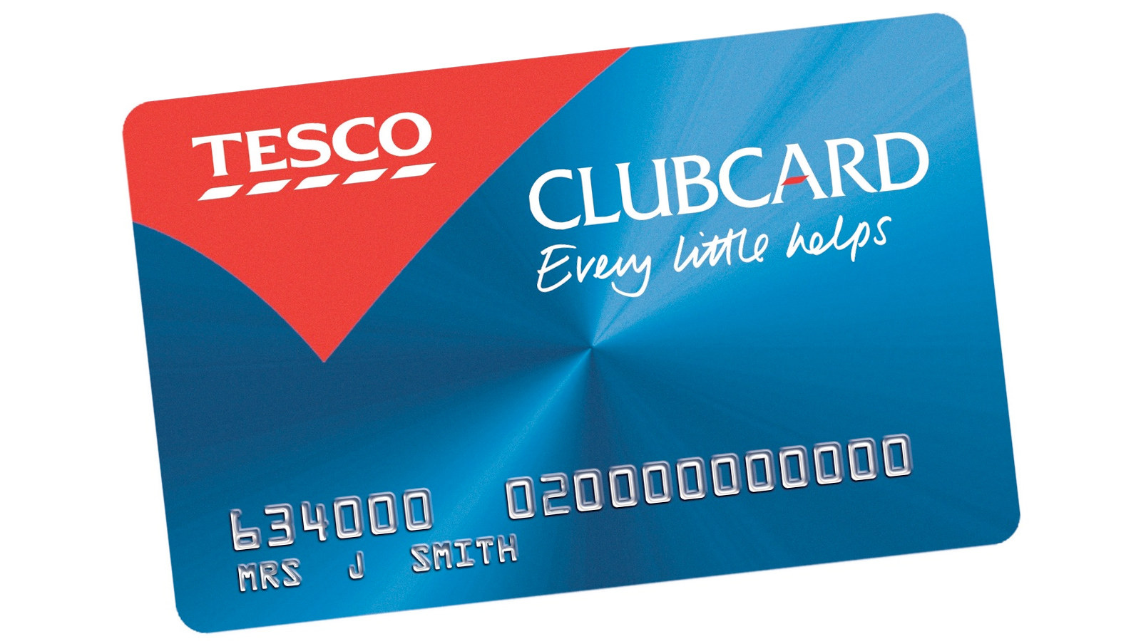
Incentivize Repeated purchase
5. Try direct mail
6. Use social proof
7. Use personalized onsite marketing based on cookies
8. Offer an enticing loyalty program
23
https://www.affirm.com/content/increase-repeat-purchases-ecommerce/

Slide 24
Engines of Growth
The Sticky Engine of Growth – Keep customers engaged over the long term and reduce churn
The Viral (or Referral) Engine of Growth – Viral invite system
The Paid Engine of Growth – Pay for each customer through ads or marketing systems
24

Slide 25
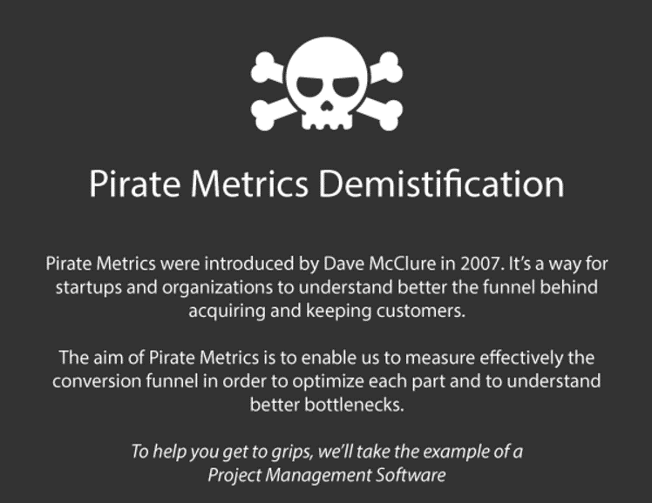
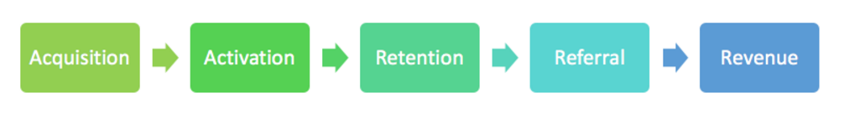
Engines of Growth & Pirates Metrics
Introduced in 2007 by Dave McClure
Better way to understand Customer Lifecycle and how to acquire and retain customers
25

Slide 26
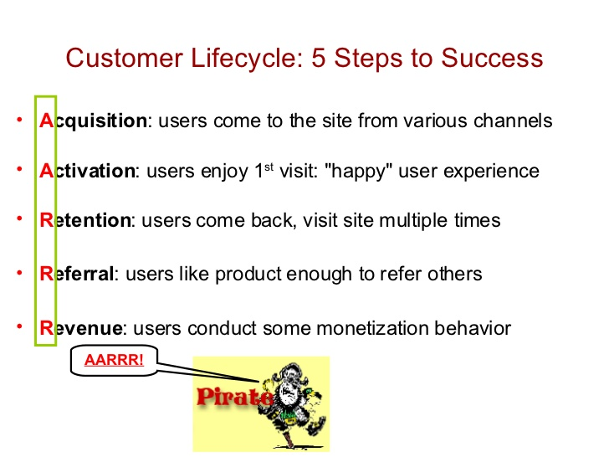

Pirates Metrics
26

Slide 27
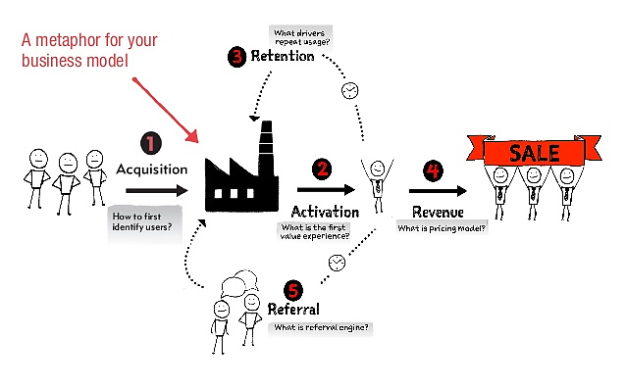
Engines of Growth & Pirates Metrics
27
*Ash Maurya, Author and Creator of Lean Canvas: https://www.slideshare.net/ashmaurya/pirate-metrics-20-aarrr

Slide 28
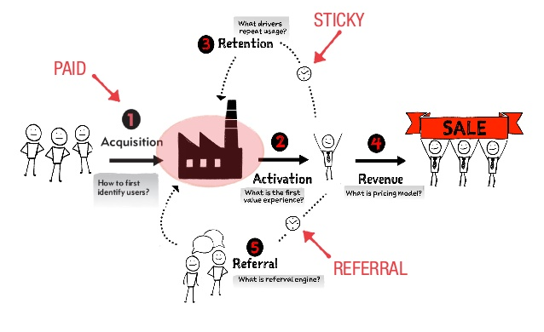
Engines of Growth
28
*Ash Maurya, Author and Creator of Lean Canvas: https://www.slideshare.net/ashmaurya/pirate-metrics-20-aarrr

Slide 29
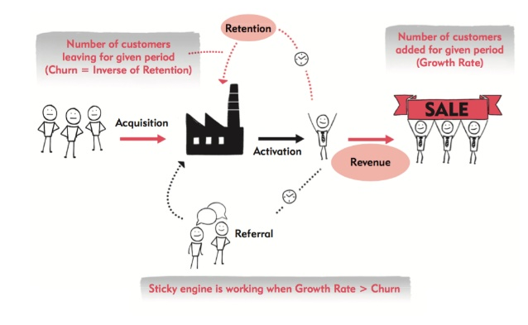
Engines and Measures: Sticky
If the rate of new customer acquisition exceeds the churn rate, the product will grow.
The speed of growth is determined by the rate of compounding
(the natural growth rate minus the churn rate)
*Ash Maurya, Author and Creator of Lean Canvas: https://www.slideshare.net/ashmaurya/pirate-metrics-20-aarrr

Slide 30
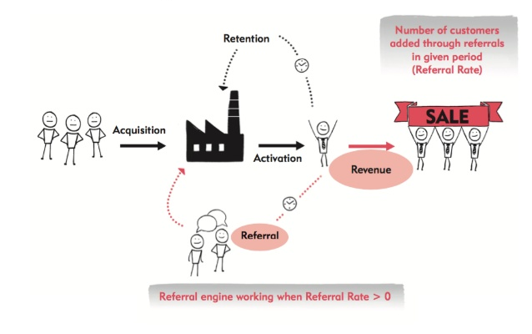
Engines and Measures: Viral
The viral loop speed is determined by a viral coefficient. The higher the faster the product will spread.
How many new customers will use a product as a consequence of each new customer who signs up.
*Ash Maurya, Author and Creator of Lean Canvas: https://www.slideshare.net/ashmaurya/pirate-metrics-20-aarrr

Slide 31
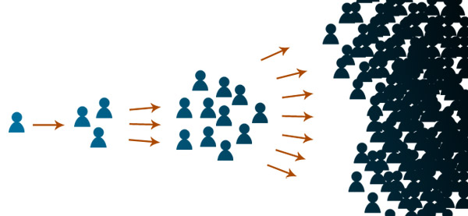
Engines and Measures: Viral
For a product with a viral coefficient of 0.1:
100 customers sign up
Each will recruit 10 friends
Each will recruit 1 friend
The end.
This is not a sustainable loop!
By contrast if the viral coefficient is greater than 1.0 it
will grow exponentially.
*Ash Maurya, Author and Creator of Lean Canvas: https://www.slideshare.net/ashmaurya/pirate-metrics-20-aarrr

Slide 32
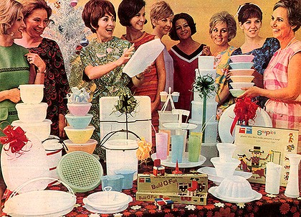
Viral as Tapperware®
“house parties,” in which customers earn commissions by selling the product to their friends and neighbours.
Every sales pitch is an opportunity not only to sell,
But also to persuade other to become representatives.
Tupperware parties are still going strong decades after they started.

Slide 33
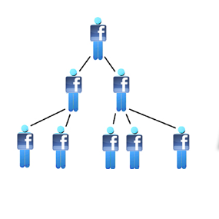
Viral as Facebook
In the viral engine of growth, monetary exchange does not drive new growth;
it is an indicator that customers value the product enough to pay for it.
If Facebook or Hotmail had started charging customers in their early days it would have impeded their ability to grow.
However customers by investing their time and attention in the product, make the product valuable to advertisers.

Slide 34
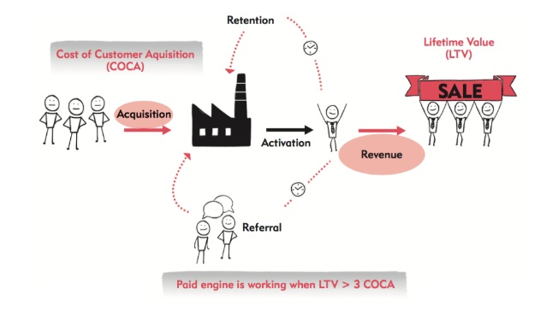
Engines and Measures: Paid
Growth in terms of Advertising? more than that.
Startups that employ an outbound sales force
Retail companies that rely on foot traffic.
All these costs should be factored into the Cost Per Acquisition(CPA)
The Customer should be measured as Life Time Value.
*Ash Maurya, Author and Creator of Lean Canvas: https://www.slideshare.net/ashmaurya/pirate-metrics-20-aarrr

Slide 35
Engines and Measures: Paid
Over time, any source of customer acquisition will tend to have its CPA bid up by competition:
If everyone in an industry makes the same amount of money on each sale,
they all will spend most of their marginal profit to the source of acquisition.
=>The ability to grow in the long term requires a differentiated ability to monetize a certain set of customers.

Slide 36
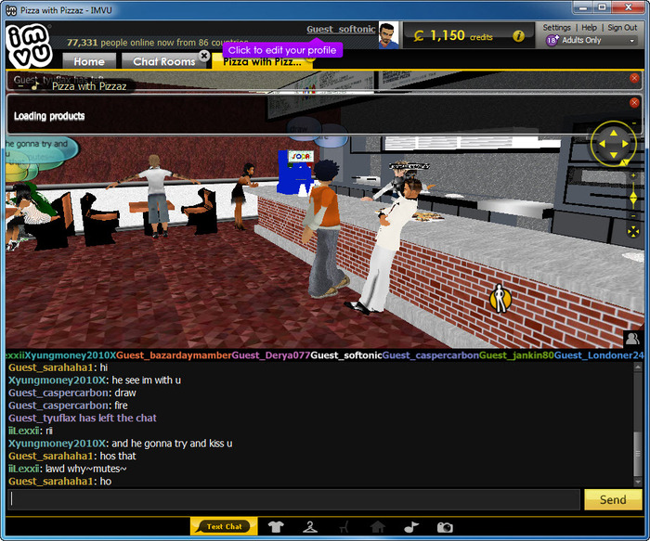

Engines and Measures: Paid
Misconception: IMVU as an add-on to existing instant messaging networks. (Viral Engine)
IMVU’s customers didn’t want to use it with existing friends. But to make new friends.
Not a strong incentive to bring new customers
IMVU was able to grow by using paid advertising, because customers were willing to pay more for the product than it costed to advertise. (Paid Engine)

Slide 37
Engines of Growth
 | STICKY | VIRAL | PAID
Approach | Keep people coming back | Make people invite friends | Spend money to get customers
Metrics | New Customer Acquisition - Churn Rate (make them faster that you loose them) | Viral coefficient (How many they tell, how fast they tell them) | Cost per Acquisition Customer Lifetime Value
Example | Database Solutions | Hotmail, Facebook | IMVU

Slide 38
Some more on Metrics: Vanity
Beware of Vanity Metrics!
A number that indicates improvement but is disconnected from the progress of your organization’s mission.

Slide 39
Some more on Metrics: Vanity
Ex. “web traffic.”
Can be a good but depend from the context:
you spending thousands of dollars on Google AdWords;
but, if no users convert into email signups,
then this additional traffic isn’t helping

Slide 40


Good Metrics Features
The three A’s of metrics:
Actionable,
Accessible,
Auditable.

Slide 41
Actionable
“Don’t be so busy learning that you don’t have time to be doing.” Bruce Van Horn
When you know the answer to that question, what decision are you going to make?
Do you really need to measure in order to make a decision?
Ex. if visitors to your site double, what are you going to change?
http://jem9.com/3-metrics/

Slide 42
Accessible
“If you want me to give you a two-hour presentation, I am ready today. If you want only a five-minute speech, it will take me two weeks to prepare.”– Mark Twain
Do your stakeholders understand your metrics?
It is much harder to make information easily accessible, especially to folks outside your specialty.
KEY DATA SHOULD BE AVAILABLE TO ANY EMPLOYEE, ANYTIME, IN A MATTER OF MINUTES
http://jem9.com/3-metrics/

Slide 43
Auditable
“….. optimism is highly valued, socially and in the market; people and firms reward the providers of dangerously misleading information more than they reward truth tellers.”― Daniel Kahneman, Thinking, Fast and Slow
Ideally any member of your team could find the source data and reproduce your report.
Design marketing metrics to be transparent
You want the writing to be on the wall so that business stakeholders and teams are taking sensible business decision.
http://jem9.com/3-metrics/

Slide 44
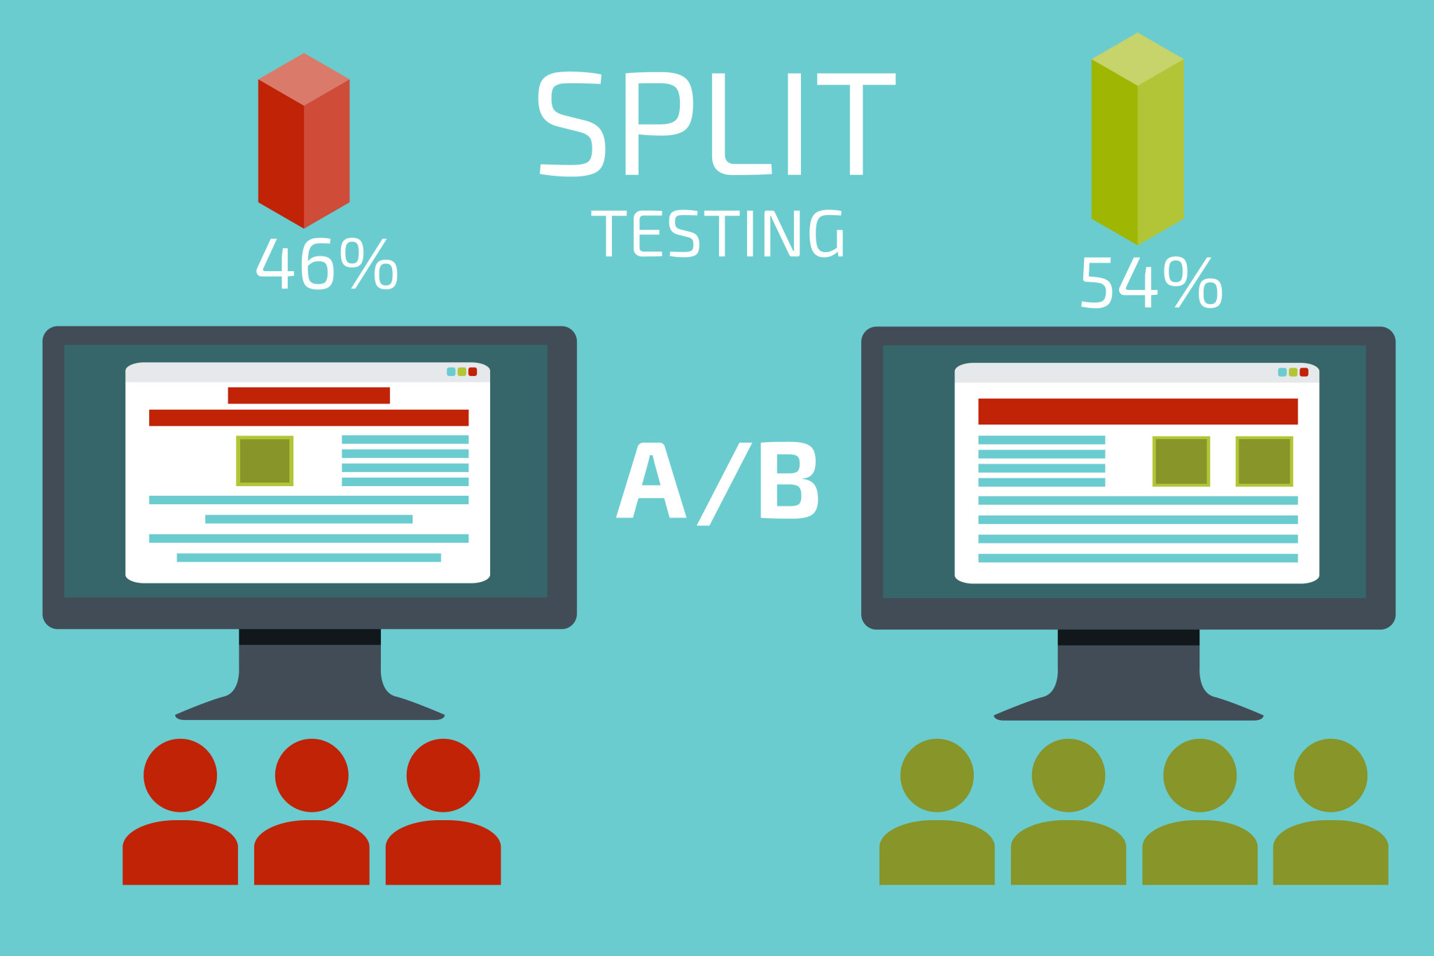
Tips for more actionable metrics
Split-tests.
A/B experiments produce the most actionable of all metrics
explicitly refute or confirm a specific hypothesis.
Integrate them into your decision loop
“if this test turns out differently from how I expect, will that cast serious doubts on what I think I know about my customers?”
an A/B system you can use is Google Website Optimizer
http://tim.blog/2009/05/19/vanity-metrics-vs-actionable-metrics/

Slide 45

Tips for more actionable metrics
Per-customer metrics.
“Metrics are people, too.”
Vanity metrics take our attention away
Look at data that is happening on a per-customer or per-segment basis.
Ex. instead of total number of pageviews in a month
the number of pageviews per new customer and returning customer.
http://tim.blog/2009/05/19/vanity-metrics-vs-actionable-metrics/

Slide 46
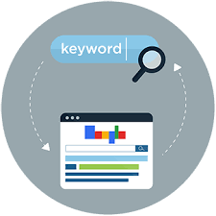
Tips for more actionable metrics
Keyword (SEM/SEO) metrics
SEM (Search Engine Marketing) and SEO (Search Engine Optimization) are great customer acquisition tactics
but can reveal important insights about customers,
treat customers acquired with a given keyword as a segment
track their metrics over time.
http://tim.blog/2009/05/19/vanity-metrics-vs-actionable-metrics/

Slide 47
Actionable metrics recap
Measure what matters. Actionable metrics help us realize we have a problem and point us in the right direction to start solving it.
Metrics are people, too. Not sure what the numbers mean? Get the customers on the phone and ask them.
Measure the Macro. not to get distracted by intermediate metrics Ex. don’t care about click-through rates, care about the customer behaviors that lead to purchase.
http://tim.blog/2009/05/19/vanity-metrics-vs-actionable-metrics/

Slide 48
Thank you!
Brought to you by EIT Digital Master School @Eötvös Lorand University
Find me at: anna.reale@inf.elte.hu

